Slide 1
Routing– Unit 3
Open Shortest Path First (OSPF)
S.V.Jansi Rani
Assistant Professor / CSE
Notes:
The University of Adelaide, School of Computer Science
Chapter 2 — Instructions: Language of the Computer

Slide 2
Link State Routing
Strategy: Send to all nodes (not just neighbors) information about directly connected links (not entire routing table).
Link State Packet (LSP)
  id of the node that created the LSP
  cost of link to each directly connected neighbor
  sequence number (SEQNO)
  time-to-live (TTL) for this packet
Reliable Flooding
  store most recent LSP from each node
  forward LSP to all nodes but one that sent it
  generate new LSP periodically; increment SEQNO
  start SEQNO at 0 when reboot
  decrement TTL of each stored LSP; discard when TTL=0
Notes:
The University of Adelaide, School of Computer Science
Chapter 2 — Instructions: Language of the Computer

Slide 3
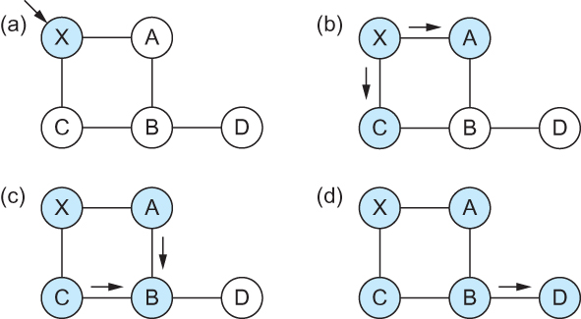
Link State
Reliable Flooding
Flooding of link-state packets. (a) LSP arrives at node X; (b) X floods LSP to A and C; (c) A and C flood LSP to B (but not X); (d) flooding is complete
Notes:
The University of Adelaide, School of Computer Science
Chapter 2 — Instructions: Language of the Computer

Slide 4
Shortest Path Routing
Dijkstra’s Algorithm - Assume non-negative link weights
  N: set of nodes in the graph
  l((i, j): the non-negative cost associated with the edge between nodes i, j ∈N and l(i, j) = ∝ if no edge connects i and j
  Let s ∈N be the starting node which executes the algorithm to find shortest paths to all other nodes in N
  Two variables used by the algorithm
    M: set of nodes incorporated so far by the algorithm
    C(n) : the cost of the path from s to each node n
    The algorithm
      M = {s}
      For each n in N – {s}
        C(n) = l(s, n)
      while ( N ≠ M)
        M = M ∪ {w} such that C(w) is the minimum
        for all w in (N-M)
        For each n in (N-M)
        C(n) = MIN (C(n), C(w) + l(w, n))
Notes:
The University of Adelaide, School of Computer Science
Chapter 2 — Instructions: Language of the Computer

Slide 5
Shortest Path Routing
# Chapter Subtitle
In practice, each switch computes its routing table directly from the LSP’s it has collected using a realization of Dijkstra’s algorithm called the forward search algorithm
Specifically each switch maintains two lists, known as Tentative and Confirmed
Each of these lists contains a set of entries of the form (Destination, Cost, NextHop)
Notes:
The University of Adelaide, School of Computer Science
Chapter 2 — Instructions: Language of the Computer

Slide 6
Shortest Path Routing
The algorithm
  Initialize the Confirmed list with an entry for myself; this entry has a cost of 0
  For the node just added to the Confirmed list in the previous step, call it node Next, select its LSP
  For each neighbor (Neighbor) of Next, calculate the cost (Cost) to reach this Neighbor as the sum of the cost from myself to Next and from Next to Neighbor
    If Neighbor is currently on neither the Confirmed nor the Tentative list, then add (Neighbor, Cost, Nexthop) to the Tentative list, where Nexthop is the direction I go to reach Next
    If Neighbor is currently on the Tentative list, and the Cost is less than the currently listed cost for the Neighbor, then replace the current entry with (Neighbor, Cost, Nexthop) where Nexthop is the direction I go to reach Next
  If the Tentative list is empty, stop. Otherwise, pick the entry from the Tentative list with the lowest cost, move it to the Confirmed list, and return to Step 2.
Notes:
The University of Adelaide, School of Computer Science
Chapter 2 — Instructions: Language of the Computer

Slide 7
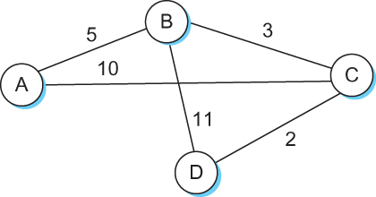
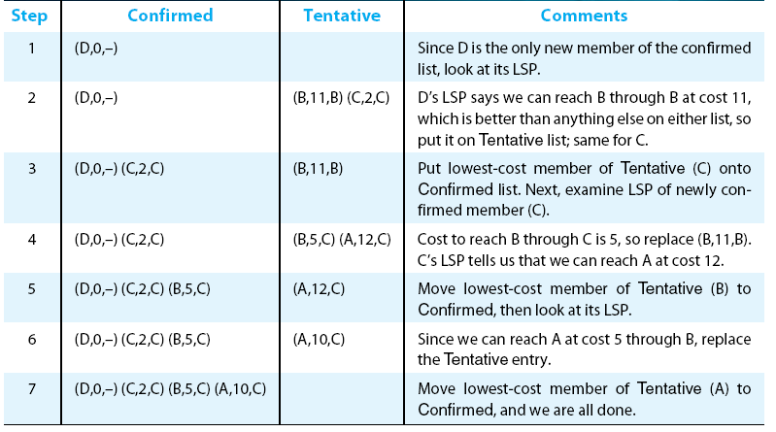
Shortest Path Routing
Notes:
The University of Adelaide, School of Computer Science
Chapter 2 — Instructions: Language of the Computer

Slide 8
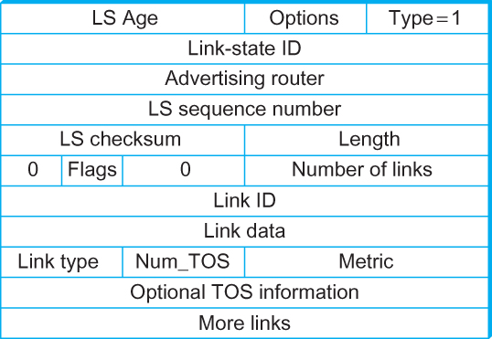
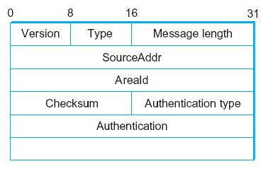
Open Shortest Path First (OSPF)
  OSPF Header Format OSPF Link State Advertisement
Notes:
The University of Adelaide, School of Computer Science
Chapter 2 — Instructions: Language of the Computer

Slide 9
THANK YOU
Notes:
The University of Adelaide, School of Computer Science
Chapter 2 — Instructions: Language of the Computer

